Slide 1
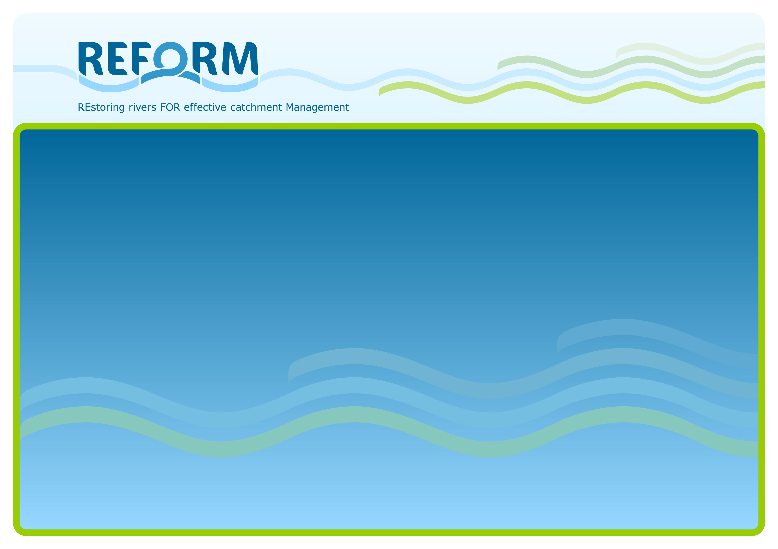
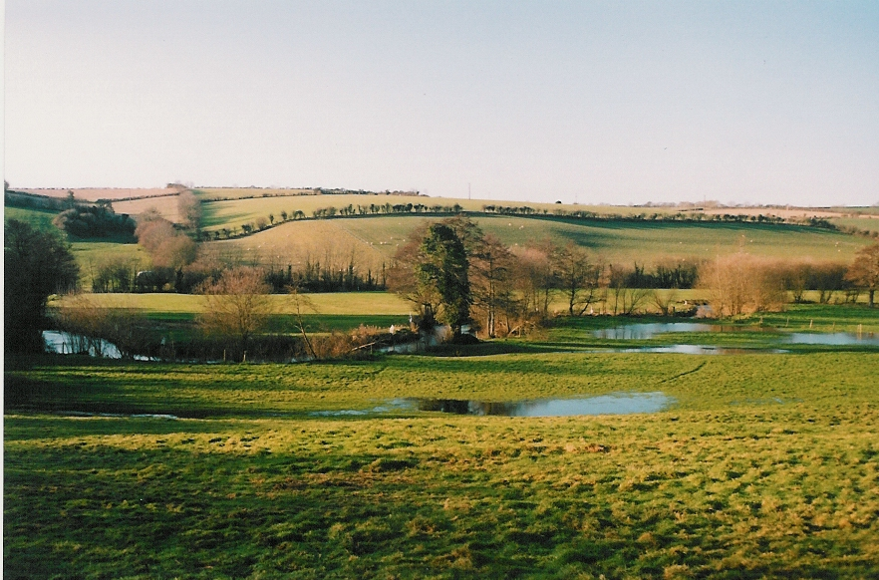
The REFORM Hydromorphology Framework:
Working with River Processes
Angela Gurnell
Queen Mary University of London
a.m.gurnell@qmul.ac.uk
Gurnell & Grabowski (2015) River Research and Applications
Notes:
River management often focuses on individual reaches of river networks, aiming to improve their ability to support human needs and those of the river ecosystem. However, the form, sedimentary and vegetation structure, and dynamism of river reaches depends not only upon natural processes and human interventions within the reach but also within the wider catchment. Furthermore, the response of river reaches to changes in processes and human pressures across the catchment is often delayed. This is because it takes time for the effects of changes (e.g. land cover change, reservoir construction) to propagate from their initial location across catchments and through river networks to individual river reaches. Thus, understanding of reach scale hydromorphology requires knowledge of processes and human pressures at not only the reach scale but at larger spatial scales including the catchment scale. The REFORM framework has been designed to aid managers in developing such multi-scale understanding of their catchments and the reaches that they contain.

Slide 2
OUTLINE
The REFORM Framework: Working with river processes
Aims
Analysis stages
Delineation
Characterisation -> Indicators
Assessment
I: River Type
II: Within Reach Features (and Human Interventions)
III: Catchment to Reach Processes (and Human Interventions)
IV: Space-time linkages and trajectories of change
Future scenarios
An Example
Notes:
This presentation describes the overall aims of the REFORM framework. It then provides a brief overview of the analysis stages incorporated within the framework. Finally, an example application of the framework to the River Frome, southern England, is outlined.
The framework can only be briefly reviewed in this presentation. However, sources of further, detailed information are provided in the last slide.

Slide 3
THE REFORM HYMO FRAMEWORK: AIMS
to develop understanding of the space-time controls at region to reach scales on river reach hydromorphology
to understand how reach hydromorphology has responded to processes and human interventions in the past and present and may respond in the future to a variety of likely scenarios
to support development of sustainable management / rehabilitation solutions for river reaches that work with river processes in the context of human constraints.
Notes:
The REFORM framework aims to help river managers develop understanding of the controls on the hydromorphology (i.e. hydrology and fluvial geomorphology) of rivers across spatial scales from biogeographical region to reach and to track how those controls and their consequences for the river system change through time.
This space-time framework allows integrated understanding of how changes in both human interventions and pressures, and hydromorphological processes affect individual reaches, providing a basis for forecasting the likely impact of future change scenarios.
Such understanding provides a firm basis for developing sustainable river management solutions.

Slide 4
THE REFORM HYMO FRAMEWORK: ANALYSIS STAGES
ANALYSIS STAGES
DELINEATION: define the spatial units for which information needs to be assembled
CHARACTERISATION: assemble information for the spatial units
INDICATORS: extract indicators from the assembled information to guide assessments of the current and past character of the spatial units and how processes operating within spatial units affect their character and also the character of receiving spatial units
ASSESSMENT: summarise understanding of linkages across space and time, assess temporal trajectory of reach type, condition, function
SCENARIOS: assess likely responses to future scenarios
Notes:
Application of the framework requires the implementation of a sequence of five analysis stages.

Slide 5
THE REFORM HYMO FRAMEWORK: 1. DELINEATION
Region: Biogeographical region (climate-vegetation).
Catchment: enclosed by watershed
Landscape unit: topography, geology, land cover
Segment: major changes in gradient, catchment area, valley confinement
Reach: consistent planform / features, bounded by major artificial longitudinal discontinuities.
Region
Catchment
Landscape unit
Segment
Reach
Geomorphic unit
Hydraulic unit
River element
Notes:
First the spatial units that underpin the analysis are delineated.
The biogeographical region in which the catchment is located dictates the broad climate regime and the range of potential vegetation types and species that the catchment may contain.
The catchment to reach units are defined using a standard set of criteria. For example, landscape units are areas defined by their broad elevation and relief characteristics, and their assemblage of rock types and land cover types.
Pan-European data sets are available to support delineation of the spatial units if suitable national data sets are not available.
The units are nested within each other so that, for example, one landscape unit contains one or more complete segments and one segment contains one or more complete reaches.

Slide 6
THE REFORM HYMO FRAMEWORK: 2. CHARACTERISATION -> INDICATORS
Region
Past Changes
Catchment
Flow and sediment from the catchment
Landscape unit
Past Changes
Segment
Reach
River type
Geomorphic unit
Interventions, flow and sediment form features within the reach
Past Changes
Hydraulic unit
River element
Notes:
Once the delineation of the spatial units is complete, information is assembled to characterise those units in the present and, where possible, in the past. Characterisation provides an opportunity to build knowledge of the data sets that are available for the catchment and its spatial units so that the data sets can be used to quantify process and intervention indicators.
A broad set of indicators are recommended to represent the character and functioning of each spatial unit now and in the past. These are open-ended to the extent that:
(i) Indicators can be represented in a flexible way, using other information identified during the characterisation phase if the precise required measurements are not available.
(ii) New indicators can be added if these are felt to be appropriate for building good understanding of a particular catchment.
The reach is the key spatial scale, and the key reach-scale indicator is the ‘river type’.

Slide 7
THE REFORM HYMO FRAMEWORK : 2. CHARACTERISATION -> INDICATORS
UNDERSTANDING FLOW-SEDIMENT DELIVERY
SCALE | KEY PROCESSES | EXAMPLE INDICATORS
Catchment | Water production | Average annual precipitation, Average annual water yield
Landscape Unit | Runoff production / retention | % Exposed aquifers, % Soil permeability class, % land cover classes
 | Fine and coarse sediment production | Annual soil erosion, Coarse sediment source areas
River Segment | Valley features | Valley confinement and gradient, River confinement
 | Flow regime and extremes | Flow regime type, Average annual flow, Base flow index, Median, 2yr 10 yr floods
 | Sediment delivery and transport regime | Eroded soil delivery , Segment sediment budget
 | Disruption of longitudinal continuity | Number of major blocking and spanning structures (e.g. dams, drop structures, weirs, bridges)
 | Riparian corridor size, functions, succession, wood delivery | Average riparian corridor width, Continuity of riparian vegetation along river edge, Age structure of riparian vegetation
Notes:
Indicators for catchment to segment scale spatial units provide understanding of the flow and sediment transport regimes delivered to each reach. These are compared with the ‘river type’ indicator to assess the degree to which the type appears to be adapted to the process regime.
Changes in these indicators through time allow the nature and causes of process changes to be assessed.

Slide 8
THE REFORM HYMO FRAMEWORK: 2. CHARACTERISATION -> INDICATORS
UNDERSTANDING PROCESS-FORM WITHIN A REACH INDICATORS
SCALE | KEY PROCESSES | EXAMPLE INDICATORS
Reach | Stream power | Specific stream power at contemporary bankfull width
 | Flooding extent | % Floodplain accessible by flood water
 | Channel type and dimensions | River type, Floodplain type, Average bankfull channel width, depth, slope, Bed and bank sediment size, Presence of geomorphic units typical of channel and floodplain type
 | Contemporary evidence of channel adjustments | Eroding, laterally aggrading banks, Channel widening, narrowing, bed incision, bed aggradation, Vegetation encroachment
 | Historical evidence of channel adjustments. | Changes in channel width, Sinuosity, braiding, anabranching indices, Rate of lateral channel movement
 | Constraints on channel adjustments, water, sediment, wood continuity | Average width of erodible corridor, Longitudinal continuity, Lateral continuity
 | Vegetation dynamics (riparian, aquatic vegetation and wood) | % Riparian corridor under riparian vegetation, Riparian vegetation age structure, Large wood and fallen trees in channel and riparian corridor, Aquatic plant extent, Abundance of riparian tree and large wood associated geomorphic units, Abundance of aquatic plant associated geomorphic
Notes:
Indicators derived for the reach and for sub-reach spatial units (geomorphic units, hydraulic units and smaller river elements such as plant stands, sediment patches, pieces of large wood) are used to assess the degree to which the reach properties are appropriate for the river type, suggesting that the reach is functioning or could function in a relatively natural way, or whether another river type (usually selected from other types present within the landscape unit) would be more appropriate in the context of rehabilitation / restoration.
Changes in reach indicators through time allow a temporal trajectory of channel and floodplain changes to be constructed.

Slide 9
THE REFORM FRAMEWORK: 3. ASSESSMENT, I RIVER TYPE
I: RIVER TYPE. What does my reach look like?
Present river type?
Confined by its valley?
One or more flowing channels?
Straight, sinuous, meandering?
River bed sediment (bedrock, boulders, cobbles, gravel, sand, silt, clay)?
Historical changes?
Has the river type changed?
Has the river moved laterally?
Region
Catchment
Landscape unit
Segment
Reach
Geomorphic unit
Hydraulic unit
River element
Notes:
Based on the indicators, a range of assessments are produced, starting at the reach scale, where the current state and historical changes are assessed.

Slide 10
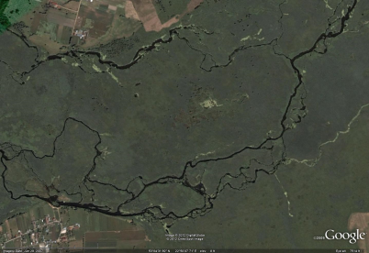
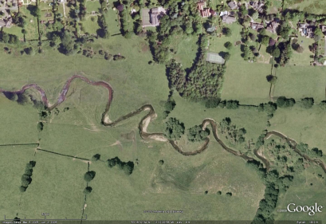
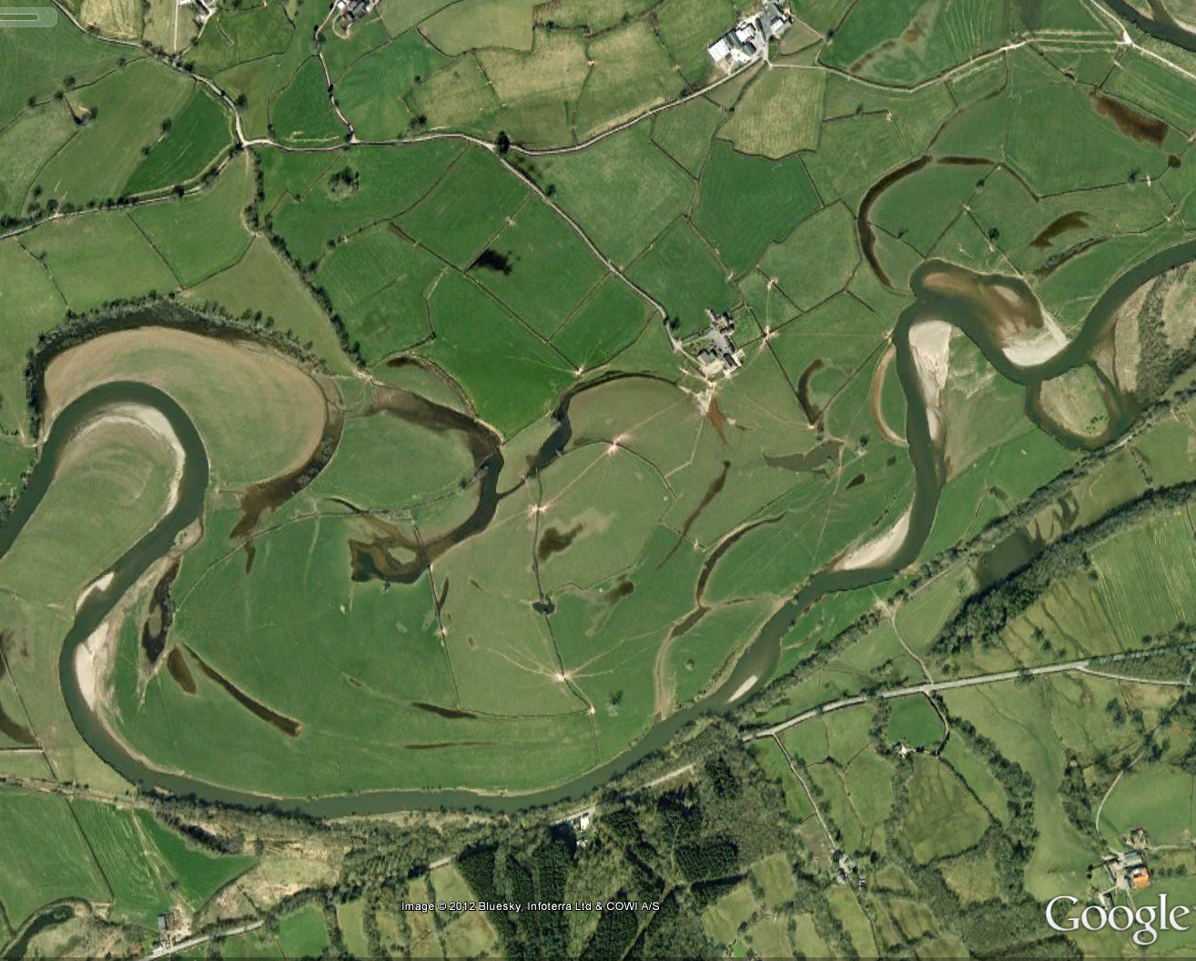
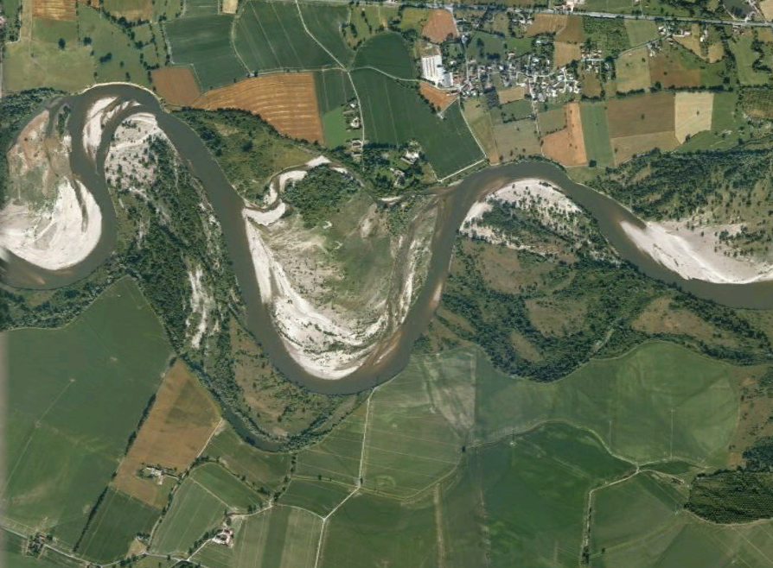
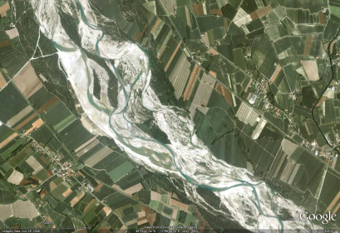
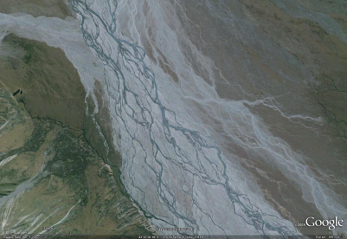
THE REFORM FRAMEWORK: 3. ASSESSMENT, I RIVER TYPE
THERE ARE MANY HYDROMORPHOLOGICAL RIVER TYPES
Image: Google Earth 2015, Infoterra Ltd & COWI A/S, Bluesky
Image: Google Earth 2015, Infoterra Ltd & Bluesky, Getmapping plc
Image: Google Earth 2015, NASA, Digital Globe
Image: Google Earth 2015, Digital Globe
Image: Google Earth 2015,
European Space Imaging
Image: Google Earth 2015
Flow, Sediment Transport
Vegetation colonisation and growth
Notes:
There are many naturally-functioning hydromorphological river types, which reflect interactions between fluvial processes and vegetation under local valley width, gradient and geological constraints. The six illustrated river types represent a gradient from very low energy, vegetation dominated conditions (top, left) through increasingly strong flow and sediment transport disturbances that are moderated less and less by vegetation (left to right along top row and then along bottom row) to very high energy conditions with negligible vegetation influence (bottom, right).

Slide 11
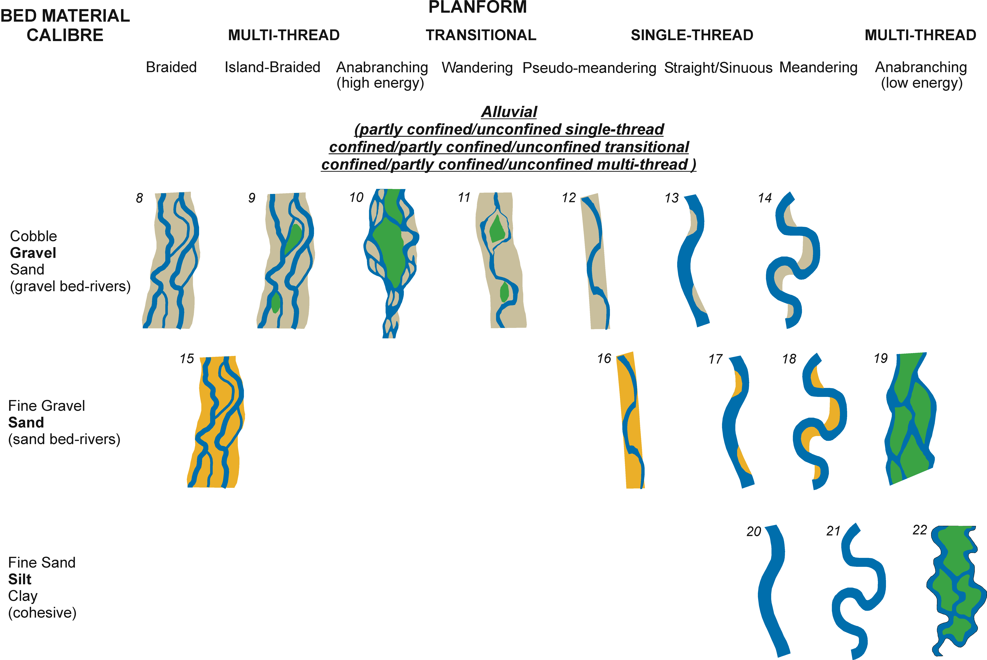
THE REFORM FRAMEWORK: 3. ASSESSMENT, I RIVER TYPE
22 river (reach) types
(Type 0 = ‘artificial’ if bed material is artificial)
Notes:
The REFORM framework defines 22 river types (1 to 22) plus a single artificial type (0) which occurs where the river bed is composed of artificial materials (e.g. concrete). The river type is defined from aerial imagery (confinement – unconfined, partly confined, confined; planform – single thread straight / sinuous, single thread meandering, transitional, multi-thread braided, multi-thread island braided, multi-thread high-energy anabranching, multi-thread low-energy anabranching) plus information from other sources on bed material calibre (bedrock, boulder, cobble, gravel, sand, silt, clay). Of course there are no rigid class boundaries between different river types – a continuum exists in reality. However, one of the defined types can usually provide a reasonable description of a reach. This provides a starting point for assessing whether the river reach is functioning according to its type or is simply exhibiting a planform pattern that is heavily constrained by human pressures and direct interventions.

Slide 12
THE REFORM FRAMEWORK: 3. ASSESSMENT, II WITHIN REACH FEATURES
II: WITHIN REACH FEATURES.
Are features appropriate for the hydromorphological river type and in good condition?
Present Features?
Features in the river channel appropriate?
Features in the river margins appropriate?
Features in the floodplain appropriate?
Feature Types and Causes of Changes?
Features degraded or inappropriate?
Features been removed / constrained by human actions?
Floodplain features suggest a different river type in the past?
Region
Catchment
Landscape unit
Segment
Reach
Geomorphic unit
Hydraulic unit
River element
Notes:
Within-reach features are assessed to evaluate past and present hydromorphological condition of the reach (river-riparian-floodplain), and the degree to which condition is and has been affected by human actions within the reach.

Slide 13
THE REFORM FRAMEWORK: 3. ASSESSMENT, II WITHIN REACH FEATURES
Type | Geomorphic Units | Stability | Description
0 | Possible occasional B | Very Stable | Highly modified reaches
1 | RS, C, Ra | Usually strongly confined and highly stable | Sediment supply-limited channels with no continuous alluvial bed
2 | BL, C, SS, AC | Can be highly unstable | Small, steep channels at the extremities of the stream network
3 | Poorly defined, featureless. | Very stable, shallow (often ephemeral) channels | Small, relatively low gradient channels at the extremities of the stream network
4 | C, P | Stable for long periods but occasional catastrophic destabilisation | Very steep with coarse bed material consisting mainly of boulders and local exposures of bedrock
5 | SP | Stable for long periods but occasional catastrophic destabilisation | Sequence of channel spanning accumulations of boulders and cobbles (steps) separated by pools
6 | G, Ra, FB, FP | Relatively stable for long periods, but floods can induce lateral instability and avulsions | Predominantly single thread but secondary channels are sometimes present
7 | R, P, G, LB | Subject to frequent shifting of bars | Coarse cobble-gravel sediments sorted to reflect the flow pattern and bed morphology
8 | MCB, R, P | Usually highly unstable both laterally and vertically | Multiple channels separated by active bars (bar-braided)
9 | I, MCB, R, P | Usually unstable both laterally and vertically | Distinguished from type 11 by > 20% channel area covered by islands of established vegetation
10 | I, R, P | Lateral instability usually present | Islands covered by mature vegetation extend between channels
11 | I, MCB, MB, R, P | Usually highly unstable both laterally and vertically | Exhibit switching from single to multi-thread
Notes:
The tables in this and the following slide summarise the wide range of information provided on sub-reach features that are characteristic of the defined river types (0 to 22) and that can help to evaluate whether a particular reach is showing some natural hydromorphological functioning.

Slide 14
THE REFORM FRAMEWORK: 3. ASSESSMENT, II WITHIN REACH FEATURES
Type | Geomorphic Units | Stability | Description
12 | Large, continuous AB, R, P | Usually unstable both laterally and vertically | Differs from type 11 in its lower sinuosity and very pronounced alternating lateral bar development
13 | Large alternate (continuous) PB, R, P | Subject to frequent shifting of bars | Sinuous pattern with discontinuous bars of coarse sediment
14 | R, P, PB, Ch, Co, SB, Pbe | Laterally unstable channels subject to lateral migration | Meandering pattern with frequent point bars of coarse sediment
15 | B, RD | Unstable both laterally and vertically | Same morphology of 8 but with predominant sand material
16 | Continuous, large AB, P, RD | Vertically unstable due to bar movement and sometimes migrate laterally | Highly sinuous baseflow and alternating bars within a straight to sinuous channel
17 | R, P, PB, RD, occasional Be, SB, L, Bs | Laterally unstable channels subject to lateral migration | Same morphology of 13 but with predominant sand material
18 | P, PB, RD, S, L, RSw, Bs, AC | Unstable channels subject to meander loop progression and extension with cut-offs | Same morphology of 14 but with predominant sand material
19 | I, RD, L, VIB, VIBe, RD, AC | Stable | Vegetation stabilising bars between channel threads, forming islands that develop by vertical accretion of fine sediment
20 | L, Bs | Very stable | Silt to silt-clay banks often with high organic content are highly cohesive
21 | L, Bs, Pbe | Very stable | Similar to 20 but with higher sinuosity
22 | I, L, CC, CS, Po, VIB, VIBe, AC, Bs | Very stable | Silt to silt-clay banks often with high organic content are highly cohesive; extensive islands covered by wetland vegetation
Notes:
The tables in this and the previous slide summarise the wide range of information provided on sub-reach features that are characteristic of the defined river types (0 to 22) and that can help to evaluate whether a particular reach is showing some natural hydromorphological functioning.

Slide 15
THE REFORM FRAMEWORK: 3. ASSESSMENT, II WITHIN REACH FEATURES
ERT | Floodplain Class | Floodplain Type | Bankfull Unit stream power (W m⁻²)
(1), 2, 4, 5 | High energy, non-cohesive floodplains | A. Confined, coarse textured | > 1000
3, 6, 7 |  | B. Confined, vertical accretion | 300 – 1000
8, 9, 15 | Medium energy, non-cohesive floodplains | C. Braided | 50 – 300
10, 11 |  | D. Wandering, gravel-bed | 30 – 200
12, 13 |  | E. (Sinuous / meandering) lateral migration, non-scrolled | 10 – 60
13, 14 |  | F. (Sinuous / meandering) lateral migration, scrolled | 10 – 60
16, 17, 18 |  | G. (Sinuous / meandering) lateral migration, backswamp | 10 – 60
17, 18 |  | H. (Partly-confined, sinuous / meandering) lateral migration, counterpoint | 10 – 60
20, 21 | Low energy, cohesive floodplains | I. Laterally stable | < 10
19, 22 |  | J. Anabranching (low energy), organic rich | < 10
Floodplain types defined by Nanson and Croke (1992) that are unlikely to be encountered in Europe
20 (semi-arid) | High energy, non-cohesive floodplains | K. Unconfined, vertical accretion, sandy | 300 – 600
16 (semi-arid) |  | L. Cut and fill | ~ 300
19, 22 (semi-arid) | Low energy, cohesive floodplains | M. Anabranching (low energy), inorganic | < 10
(Classification from Nanson and Croke, 1992)
Notes:
This table summarises the classes of floodplain defined by Nanson and Croke (1992), their characteristics, and the river types (1 to 22) with which they are associated.

Slide 16
THE REFORM FRAMEWORK: 3. ASSESSMENT, II WITHIN REACH FEATURES
Different floodplain types have distinctive sets of geomorphic units reflecting the formative river type
Diagrams from Nanson & Croke, 1992, Geomorphology
Notes:
These diagrams from Nanson and Croke (1992) illustrate the geomorphic and sedimentary features that may be found associated with some of the floodplain types. Such information can be used to assess whether geomorphic units observed on a floodplain are characteristic of a floodplain type that is appropriate or not for the reach river type.
If the floodplain type does not appear to be appropriate for the reach river type, this may indicate that a different river type was present in the past and/or that the current river type is modified by human actions.

Slide 17
THE REFORM FRAMEWORK: 3. ASSESSMENT, REACH & WITHIN-REACH
Reach and within-reach indicators feed into reach-based assessments:
CHANNEL TYPE AND DIMENSIONS: River type, floodplain type, river channel dimensions and dynamics, bed and bank sediment type.
HYDROMORPHOLOGICAL FUNCTION: (based on for example) Channel and floodplain units typical? Extent of bars, benches and islands. Extent of eroding and aggrading banks. Presence of aquatic plant, riparian tree and wood dependent geomorphic units.
HYDROMORPHOLOGICAL ALTERATION / ARTIFICIALITY: (based on for example) Interruptions to longitudinal continuity. Interruptions to lateral continuity. Potential for the river to adjust its dimensions and position.
RIPARIAN CORRIDOR ALTERATION / ARTIFICIALITY: (based on for example) Extent of riparian vegetation. Naturalness of spatial and age structure of riparian vegetation. Presence and abundance of large wood.
HYDROMORPHOLOGICAL ADJUSTMENT: Extent of indicators of contemporary adjustment. Degree and nature of past channel adjustments.
Notes:
Indicators of present and past reach-scale and reach-subunit-scale forms, processes and human interventions support an overall assessment of the nature of the reach and the degree to which both the river and its riparian corridor show hydromorphological function, alteration, and adjustment. The slide provides only a selection of individual indicators or groups of indicators that are included in each of the assessments.

Slide 18
THE REFORM FRAMEWORK: 3. ASSESSMENT, III CATCHMENT–REACH PROCESSES
III: CATCHMENT TO REACH PROCESSES
How is the reach affected by larger-scale influences?
Present Flow and Sediment Supply Processes?
Reach type appropriate for current flow and sediment supply?
Are other river types in the same landscape unit more appropriate for current flow and sediment supply?
Process Changes Induced by..?
Changes in catchment land use?
Changes in channel interventions (dams, weirs, reinforcement)?
Region
Catchment
Landscape unit
Segment
Reach
Geomorphic unit
Hydraulic unit
River element
Notes:
Indicators at larger spatial scales are integrated to track the processes and human pressures and interventions that affect the flow and sediment regimes delivered to river reaches. The values of the indicators allow causes and changes in flow and sediment regimes to be tracked so that the role of human pressures and interventions can be identified. They also provide a basis for assessing whether the current river type is appropriate to (i.e. can be sustained by) the current flow and sediment regime or whether other river types present within the landscape unit are more appropriate.

Slide 19
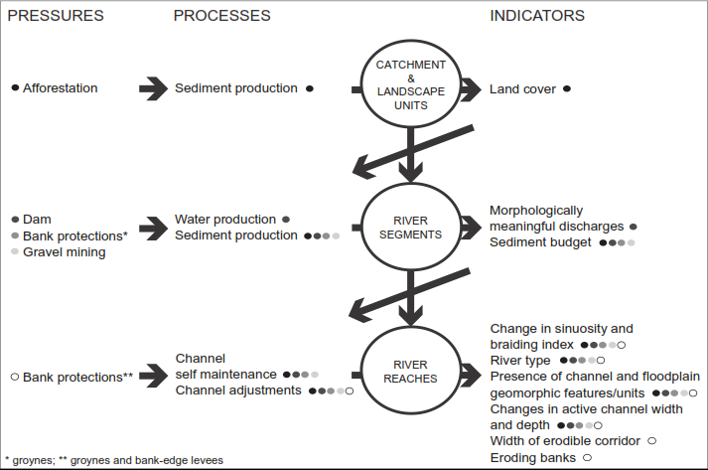
THE REFORM FRAMEWORK: 3. ASSESSMENT, IV SPACE-TIME-TRAJECTORIES
SPACE-TIME LINKAGES AND TRAJECTORIES OF CHANGE
RIVER MAGRA, ITALY: SPATIAL LINKAGES
from Belletti et al., 2015, Aquatic Sciences
Notes:
There are many ways of linking the knowledge gained from indicators of pressures and processes across space.
In this example diagram, constructed for the River Magra, Italy, the main human pressures and direct interventions are listed at the appropriate spatial scale and colour-coded from black through grey to white on the left of the diagram. The degree to which each of these pressures and interventions affect particular processes at each spatial scale is indicated by the colour codes associated with each of the processes in the second column. The relevant indicators of these process changes are listed on the right of the diagram. The diagonal arrows illustrate how indicators of changed processes at one scale feed through to processes that are further modified at the next scale.

Slide 20
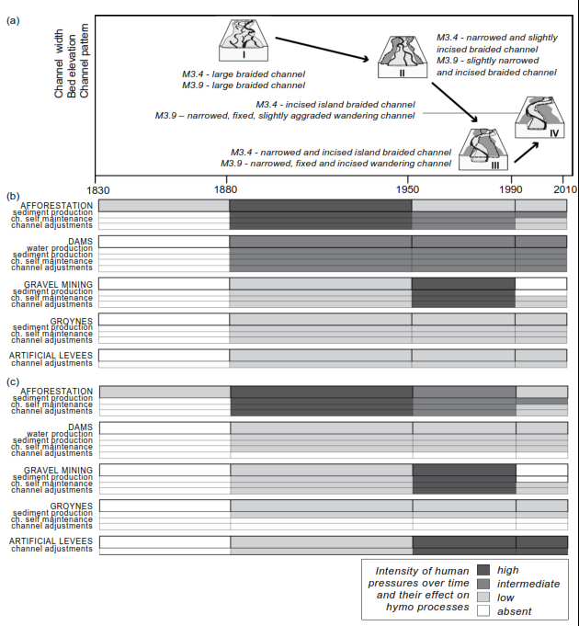
THE REFORM FRAMEWORK: 3. ASSESSMENT, IV SPACE-TIME-TRAJECTORIES
RIVER MAGRA, ITALY: TEMPORAL LINKAGES AND CHANNEL TRAJECTORIES
from Belletti et al., 2015, Aquatic Sciences
Notes:
There are also many ways of linking the knowledge gained from indicators of pressures and processes across time.
In this example diagram for the River Magra, Italy:
(a) illustrates the general temporal trend of changes in river size and type across the Magra catchment as a consequence of the pressures and processes listed in the previous slide.
(b) and (c) Illustrate chronologies of human interventions and pressures as they affect two different reaches (b or c) in different parts of the Magra catchment.

Slide 21
THE REFORM FRAMEWORK: 4. SCENARIOS
Based on integrated understanding of space-time responses and trajectories of change, likely future responses to different scenarios over forthcoming decades can be assessed:
Climate change but no change in current interventions
Other likely scenarios for the catchment, such as:
  Change in land use type / intensity
  Change in flow manipulation
  Change in channel management
Notes:
Using the detailed knowledge of changes in processes and in human interventions and pressures and the responses of river reaches in different parts (landscape units and segments) to those changes, a final stage is to consider likely reach-scale responses to future change scenarios. The consideration of future as well as past and present scenarios is crucial to building sustainable approaches to river management and rehabilitation in the catchment.
Even if human interventions and pressures are not considered likely to change, it is essential to consider one scenario – that of forecast climate changes. However, in most catchments there are additional, highly likely, future changes that should be considered, of which the most ubiquitous is change in land use and intensity. One or more realistic future scenarios should be considered.

Slide 22
THE REFORM FRAMEWORK: INPUT TO DESIGN
Questions to answer in context of management / rehabilitation design
To what extent can reach interventions be removed (in channel, in riparian margins)?
To what extent can natural processes to the reach be reinstated (catchment and local)?
How may processes change in the near future (catchment and local scenarios)?
Given 1 to 3, is current reach type the most sustainable option or is another type (of those present within landscape unit) more appropriate?
Design rehabilitation to allow river to recover its form and function as far as is possible given human constraints.
Notes:
The REFORM framework, briefly overviewed in the previous slides, allows river managers to answer a series of important questions when considering the most sustainable approaches that could be adopted in relation to river management and rehabilitation design in their catchment.

Slide 23
River Frome, Dorset: 1. Delineation
Catchment -> 3 Landscape Units - > 6 Segments - > 17 Reaches
from Grabowski and Gurnell, 2015, Aquatic Sciences
Notes:
The River Frome is an extremely low energy, lowland river in southern England. The next few slides illustrate some aspects of the application of the REFORM framework to this river and its catchment.
This slide shows the delineation of the catchment into its landscape (L1 to L3), segment (S1 to S6) and reach (1 to 17) units.

Slide 24
River Frome, Dorset: 3. Assessment I: River Type
Three reach types present
Types unchanged; Most reaches have become narrower and more sinuous, particularly in the last 50-60 years
Reach | Bed sediment | Channels | Planform | Type
1 | Gravel/sand | Single | Sinuous | 17
2 | Sand/gravel | Single | Sinuous | 17
3 | Sand/gravel | Single | Meandering | 18
4 | Sand/gravel | Single | Sinuous | 17
5 | Gravel/sand | Single | Sinuous | 17
6 | Gravel/sand | Multi-thread | Anabranching | 19
7 | Sand/gravel | Single | Sinuous | 17
8 | Sand/gravel | Single | Sinuous | 17
9 | Sand/gravel | Multi-thread | Anabranching | 19
10 | Sand/gravel | Multi-thread | Anabranching | 19
11 | Gravel/sand | Multi- | Anabranching | 19
12 | Gravel/sand | Multi- | Anabranching | 19
13 | Sand/gravel | Multi-thread | Anabranching | 19
14 | Sand/gravel | Multi-thread | Anabranching | 19
15 | Sand/gravel | Multi-thread | Anabranching | 19
16 | Sand/gravel | Multi-thread | Anabranching | 19
17 | Sand/gravel | Single | Meandering | 18
Notes:
The main stem of the river has 17 reaches. All are unconfined with gravel-sand or sand-gravel bed material and show three main planform types: single-thread sinuous, single-thread meandering, and multi-thread anastomosing. These represent river types 17, 18 and 19.
Historical maps spanning a period of around 120 years, show a pattern of generally increasing sinuosity and decreasing channel width, particularly over the last 60 years, with no change in river type over that period.

Slide 25
River Frome, Dorset: 3. Assessment II: Within-reach features
Reach | Hydromorphology function assessment (presence of features indicating natural function) | Channel / floodplain features typical of type | Artificiality assessment (constraints on natural function) | Longitudinal Continuity (impact of weirs on downstream flow of water and sediment) | Lateral Continuity (access of flood water to floodplain) | Adjustment Potential (space for channel to move, unreinforced banks)
1 | Intermediate | Some | Moderate | Intermediate | Good | Intermediate
2 | Intermediate | Some | Very Low | Good | Good | Intermediate
3 | Intermediate | Some | Low | Intermediate | Good | High
4 | Good | Some | Moderate | Poor | Good | Intermediate
5 | Good | Some | Moderate | Poor | Good | Intermediate
6 | Good | Some | Moderate | Poor | Good | Intermediate
7 | Good | Some | Moderate | Poor | Good | High
8 | Intermediate | Some | Moderate | Poor | Good | Intermediate
9 | Intermediate | Some | Moderate | Poor | Good | Intermediate
10 | Intermediate | Some | Moderate | Poor | Good | Intermediate
11 | Intermediate | Some | Moderate | Poor | Good | Intermediate
12 | Intermediate | Some | Moderate | Poor | Good | High
13 | Good | Some | Moderate | Poor | Good | High
14 | Intermediate | Some | Moderate | Poor | Good | Intermediate
15 | Intermediate | Some | Moderate | Poor | Good | Intermediate
16 | Good | Some | Moderate | Poor | Good | High
17 | Intermediate | Some | Moderate | Poor | Good | Intermediate
Notes:
Assessments of reach-scale and sub-reach-scale indicators reveal:
Intermediate to Good (on a Very Poor to Very Good, 5 point scale) hydromorphological function with some channel and floodplain features evident that are typical of the river and floodplain type.
Moderate to Very Low (on a Very High to Very Low, 5 point scale) artificiality reflects generally poor longitudinal continuity reflecting the presence of numerous weirs; generally good lateral continuity as flood water can access most of the floodplain; and generally intermediate lateral adjustment potential because a good proportion of river banks are not reinforced.

Slide 26
River Frome, Dorset: 3. Assessment II: Within-reach features
Lack of natural riparian zone.
2. Few riparian trees.
3. Plentiful aquatic vegetation in unshaded channels.
4. Features in channels and edges formed mainly by sediment trapped by aquatic vegetation.
Photographs and diagram from Gurnell and Grabowski, 2015, River Research and Applications
Notes:
Within-reach features reveal a lack of functioning riparian zone and riparian trees (riparian corridor alteration / artificiality is high). The lack of shade and low energy of the river has allowed the development of abundant and diverse aquatic vegetation. Numerous aquatic plant dependent geomorphic units are evident within the channel where emergent aquatic plants are trapping and stabilising sand and finer sediment.
The map illustrates changes in the encroaching edge of vegetation along a particularly active reach between 2002 and 2008. Vegetated ‘islands’ (mainly stands of emergent aquatic plants retaining sediment) at one date can be seen to be incorporated into the vegetated channel margins at later dates. The map illustrates channel migration and narrowing and increasing channel sinuosity over the 6 year period.

Slide 27
River Frome, Dorset: 3. Assessment III: Catchment to reach processes
Land use intensification increases soil erosion:
more & different animals, increased cereals and yields.
2. Agriculture close to channel (no riparian woodland to intercept eroded sediment).
3. Therefore, eroded sediment delivered to river channel.
4. River flows have insufficient energy to move sediment.
Fine sediment accumulates in river channel.
Aquatic vegetation traps sediment causing channel narrowing and increased sinuosity
Diagrams from Grabowski and Gurnell, 2015, Aquatic Sciences
Notes:
At the catchment scale, significant changes in land use (shift from pasture to cultivated agriculture), the crops grown (shift towards cereals), the animals reared and their numbers (shift towards cattle and pigs and an increase in total numbers), and crop yields (yields have increased suggesting more intensive cultivation practices) indicate an overall shift in the nature and intensity of agricultural production with major changes occurring since the 1940s.
Modelling indicates that these changes have delivered increasing sand and finer sediment loads to the river and that the river is very rarely competent to move its gravel bed and shows a positive finer sediment budget within all segments along the main stem apart from the extreme headwaters (segment 1).
The result is accumulation of finer sediment within the river channel, where it infiltrates the gravel bed and accumulates on top of the bed in slackwater areas. The accumulation, retention and stabilisation of sediment within aquatic plant stands, and resultant channel narrowing illustrated in the previous slide, appears to be driven by the change in finer sediment delivery to the river, particularly over the last 70 years. This corresponds with the trend of narrowing and increased sinuosity identified between the 1960-1975 historical maps and the 2013 map.

Slide 28
River Frome, Dorset: 3. Assessment IV: space-time and trajectories of change
Notes:
This space-time diagram assembles evidence for changes and their causes in the single thread (left) and multi-thread (right) reaches of the River Frome over three periods bounded by (i) >> 100 years ago, (ii) 100 years ago, and (iii) the present. These periods can be described as before heavy human impact (over several centuries ago); affected by widespread floodplain drainage, water spreading (water meadows) and weir installation (from one century to several centuries ago); affected by an increasing area of cultivation and intensification of both arable agriculture and animal husbandry (the last century).

Slide 29
River Frome, Dorset: 4. Scenarios
A warming climate with increased intensity of rain storms
More peaked flow hydrographs (unlikely to be significant). Increased fine sediment delivery to the river network (intense rain on bare arable fields). Increased fine sediment retention, further channel narrowing, siltation of the channel bed, and potential siltation and blockage of side channels.
Removal of some structures from the river network
Improve sediment transport with some local sediment flushing.
A change in agricultural land cover and management practices (maintain cover on fields when rainfall most intense (e.g. spring rather than autumn planting) and break up runoff using grass strips)
Maintain fine sediment delivery at current levels under a changing climate.
A relaxation of riparian and aquatic vegetation management.
Reduced fine sediment delivery to river; increased complexity of in-channel and marginal landforms; overall improvement in riparian and aquatic habitat diversity and turnover.
Notes:
Four future scenarios were considered for the River Frome, with future climate change incorporated in all of them.

Slide 30
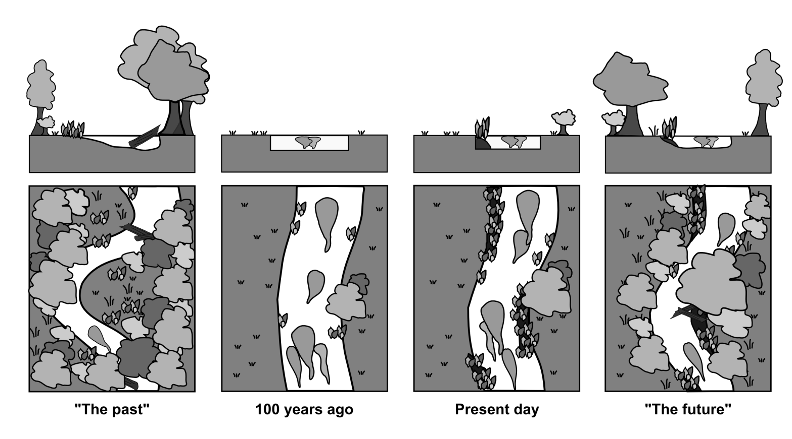
River Frome, Dorset: Rehabilitation actions under Scenario (iv)
River type is appropriate but need to improve process-form interactions
Where possible, increase width of riparian zone: reduces eroded sediment delivery to channel; increases shade; reduces aquatic vegetation and cools water temperatures.
Where possible, remove weirs and other blocking structures: improves potential of river flows to transport sediment.
Where possible remove bank reinforcement: allows river to adjust course.
Leave vegetation and river morphology to co-adjust:
  existing river types have persisted so are quite stable
  aquatic plants and wood from riparian trees will retain a reduced fine sediment supply to build a more dynamic mosaic of naturally-functioning habitats with gravel bed exposed in between.
from Grabowski and Gurnell, 2015, Aquatic Sciences
Notes:
Based on the application of the REFORM framework, this slide proposes rehabilitation actions assuming adoption of scenario (iv) in as many reaches as possible.

Slide 31
FURTHER READING AND RESOURCES
Gurnell et al. (2014) REFORM Deliverable 2.1
Part 1: A hierarchical multi-scale framework and indicators of hydromorphological processes and forms
  Part 2: Thematic Annexes
  Part 3: Catchment Case Studies: Full applications of the Hierarchical Framework
  Part 4: Catchment Case Studies: Partial applications of the Hierarchical Framework
Aquatic Sciences (Special issue on the REFORM Framework) expected 2015:
  A hierarchical framework for developing understanding of river behaviour.
  Classification of river morphology and hydrology to support management and restoration.
  Indicators of river system character and dynamics, past and present: understanding the causes and solutions to river management problems.
  The use of Remote Sensing to characterise hydromorphological properties of European rivers.
  Several papers illustrating different applications of the REFORM framework.
www.reformrivers.eu wiki.reformrivers.eu
Notes:
More information can be obtained from REFORM deliverable 2.1, which can be downloaded from http://www.reformrivers.eu/results/deliverables and from a special issue of the journal Aquatic Sciences, which is currently going through the review and publication process and should be available within 2015.

